Slide 1
Project Title
Beyond Words:Exploring Action Detection in Sign Language
Team Members
B.L.J.Prathyusha 20B81A3379
I. Varudhini Lakshmi Sri 20B81A33B4
S. Vikram 20B81A33B7
Under Supervision
Mr. Azmera Chandu Naik
Sr. Assistant Professor, Dept of CSE (AI&ML)

Slide 2
Domain Introduction:
Sign Language:
Sign language is a non-verbal communication method using gestures, facial expressions, and body language used mostly by deaf and dumb community.
Deep Learning:
Deep learning is a subset of machine learning that employs neural networks with multiple layers to autonomously learn and extract intricate patterns from vast amounts of data.
LSTM model is used in this use case to deduce a pattern from temporal order of keypoints extracted from sequential frames of action(i.e. sign language) input / video input.
Natural Language Processing:
NLP is a branch of AI that focuses on the interaction between computers and human language.
In this use case, NLP is used to convert the resultant output action text to speech, so that non-sign language speakers can understand more easily in a live video stream mode of communication.

Slide 3
Challenges and Problem Statement:
Deaf and dumb individuals face difficulty expressing themselves through conventional spoken language, limiting their means of communication.
The absence of audible communication makes it difficult for them to fully understand what others are saying, leading to communication gaps and may also experience social isolation, impacting their overall quality of life.
Problem Statement: Develop a sign language action detection system that interprets dynamic hand gestures and body movements of individuals with hearing impairments in live video stream and automates translation of sign language into text or spoken language to facilitate seamless communication.

Slide 4
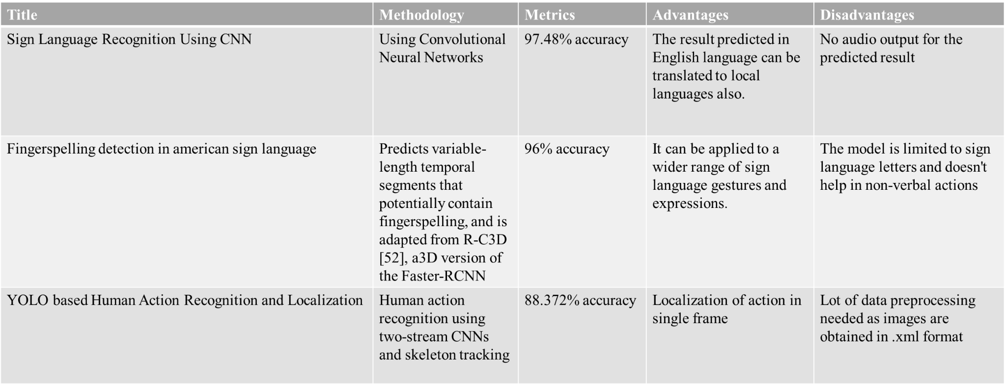
Existing Methodologies:

Slide 5
Proposed Methodologies:
Our project aims to enhance communication for the deaf and dumb community by employing innovative methodologies that integrate advanced technologies. The proposed methodologies encompass the following key components:
Develop a robust LSTM model that excels in capturing temporal dependencies, enabling accurate detection and interpretation of intricate actions within sign language expressions.
Implement a dynamic display system to visually represent the interpreted sign language.This system will enhance communication during virtual meetings and other interactive settings.
Leverage NLP techniques to integrate voiceover capabilities seamlessly. This will allow the system to provide spoken representations of the interpreted sign language, enhancing accessibility for users who prefer auditory communication.

Slide 6
Technology Stack:
Python
- Used to perform overall actions and also used it for accessing the existing dependencies
OpenCV
- Used for capturing the gestures
MediaPipe
-Used to draw the landmarks on the image based on results obtained from mediapipe
holistic model
TensorFlow
- Used for model building i.e building customized layers
- Used for model compilation and model training

Slide 7
Module Structure:
Capture gesture
Capturing the gestures in the form of images using opencv
Train the model
The captured frames are converted to RGB format and then face, hand landmarks are extracted using mediapipe holistics.
This data is in numpy array format, it is preprocessed for maintaining uniform dimensions.
The processed landmark data is passed as input to the TensorFlow pre-trained model for classification.
Predict gesture and Perform action
After predicting the gesture by the model, the result is shown in the form of text and voice over is added to predicted result.

Slide 8
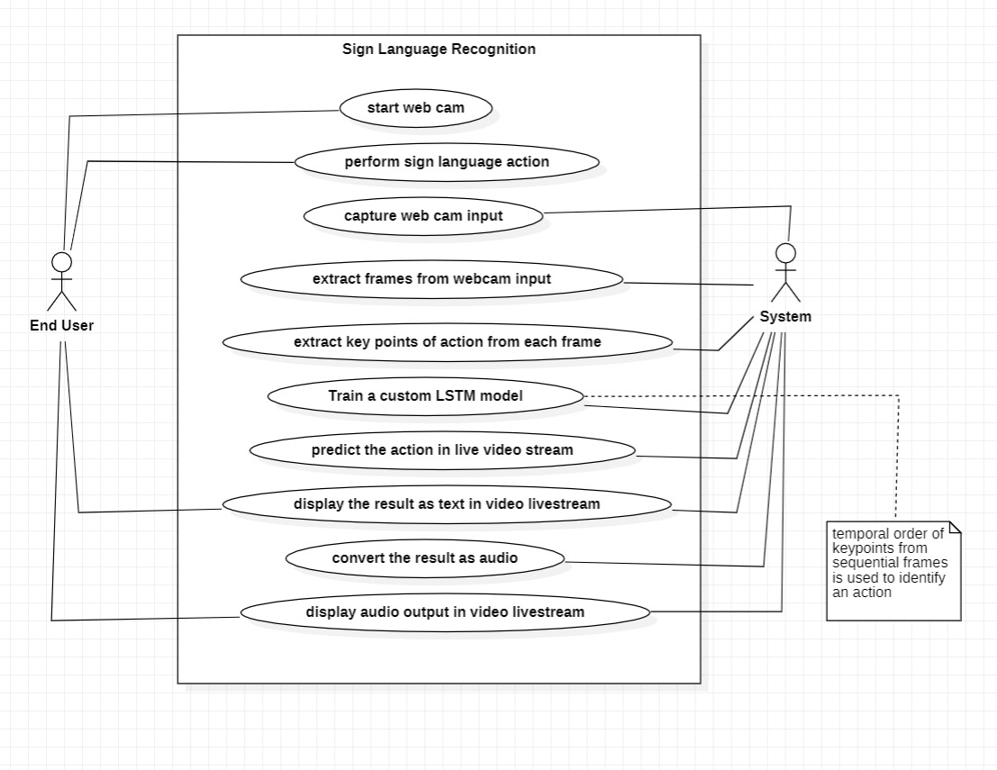
Usecase Diagram:

Slide 9
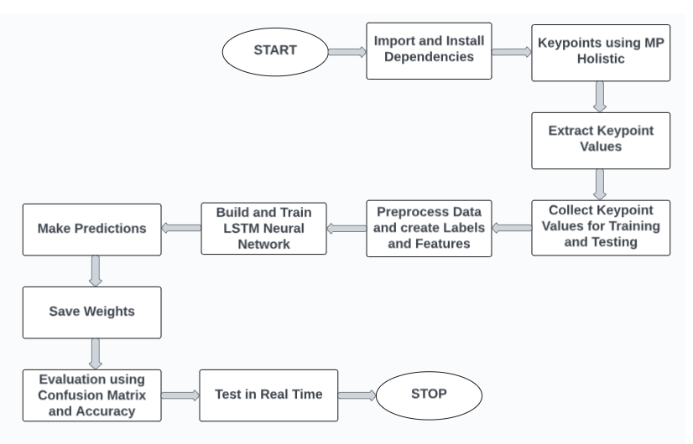
System Architecture:

Slide 10
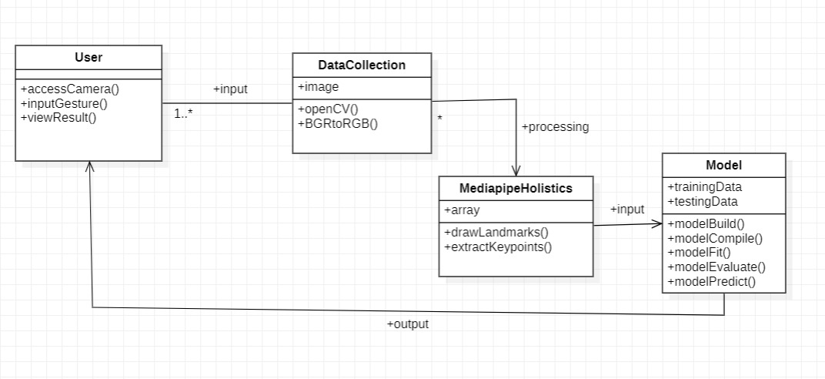
Class Diagram:

Slide 11
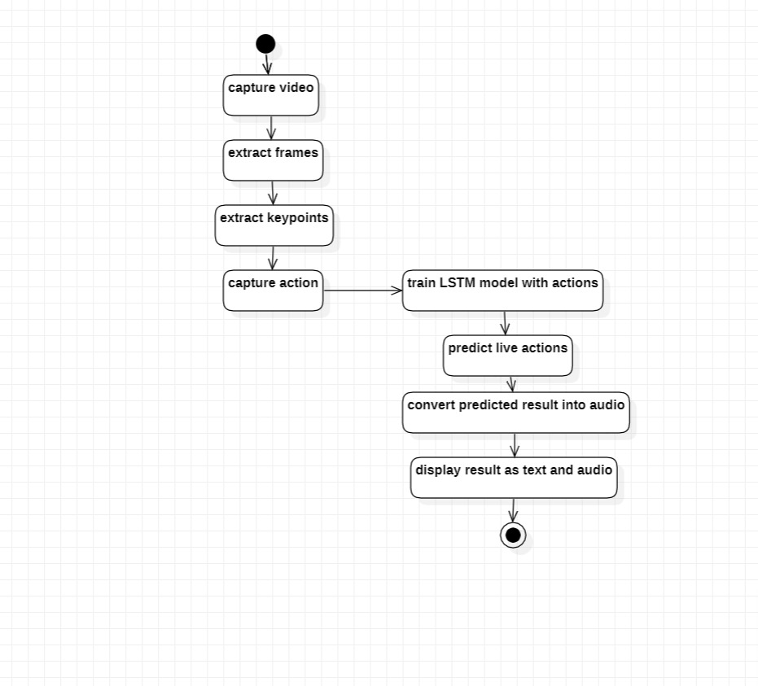
Activity Diagram:

Slide 12
Contribution of Students:
Team Member 1:
B.L.J.Prathyusha - 20B81A3379
Implementation of code to process the captured landmarks.
Contributing in training the LSTM Model with different gestures.
Contributing in adding the voice over to the predicted gesture.

Slide 13
Team Member 2:
Inakollu Varudhini Lakshmi Sri - 20B81A33B4
Contributing in testing the LSTM Model with various hand gestures
Contributing in identifying the modules to be used in python for our project
Implementation of code for live gesture capturing and pass them to train the model

Slide 14
Team Member 3:
S Vikram - 20B81A33B7
Contributing in conducting the literature survey to understand the existing problem
Contributing in collecting the gestures for training the model
Contributing in coding for the evaluation and performance of the model.

Slide 15
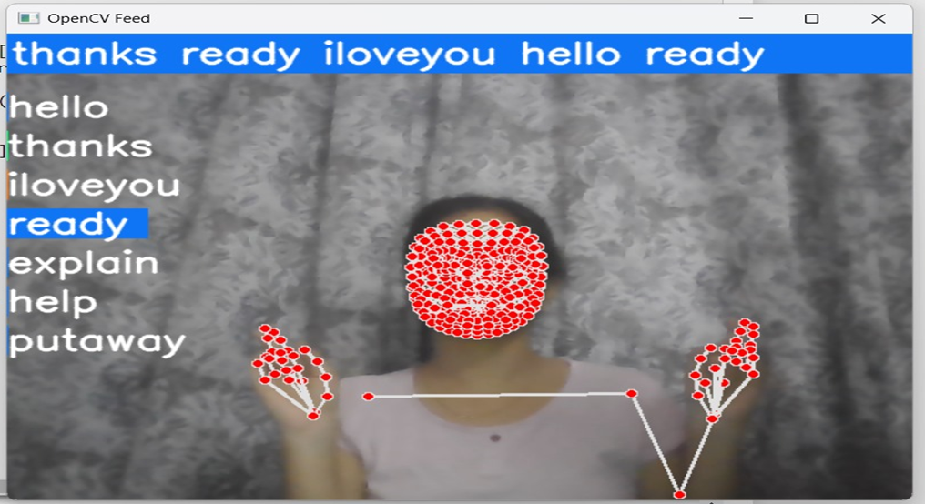
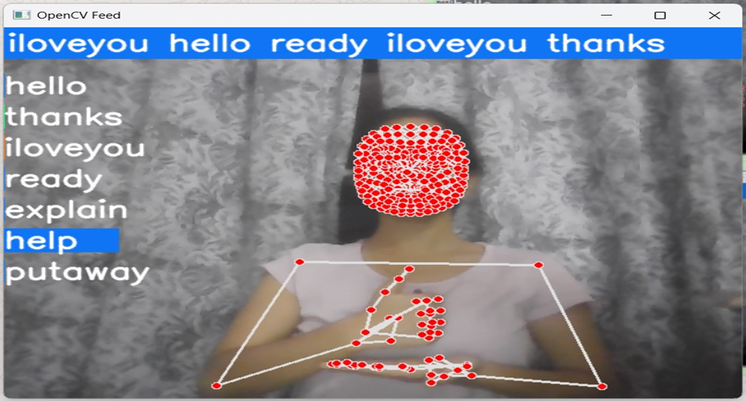
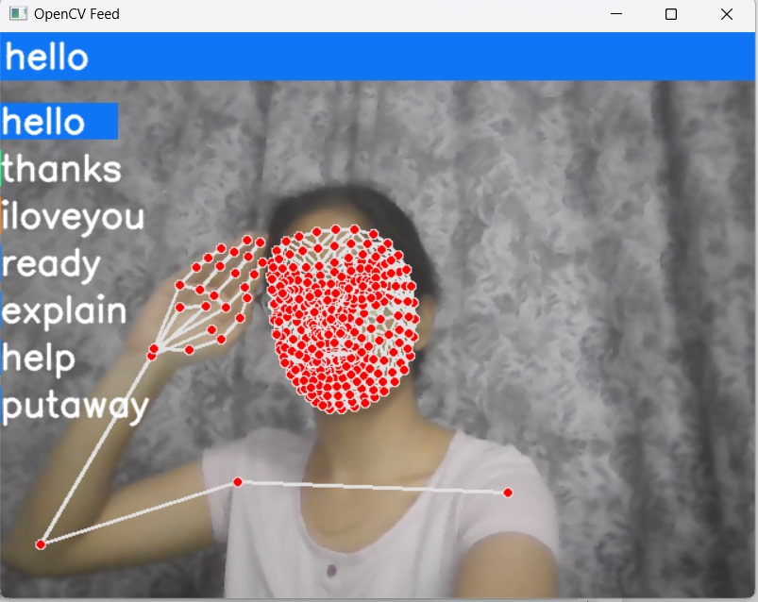
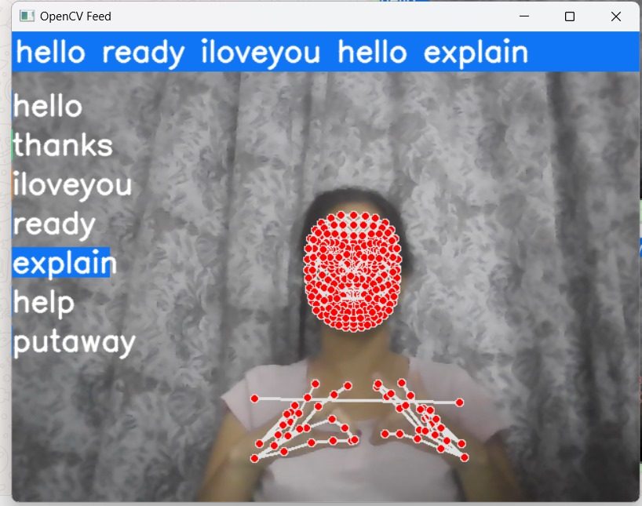
Results and Discussions:

Slide 16
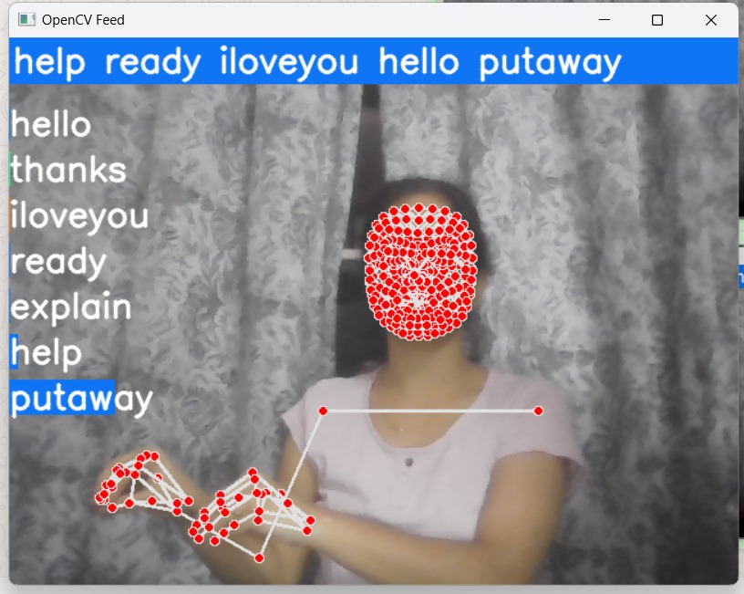
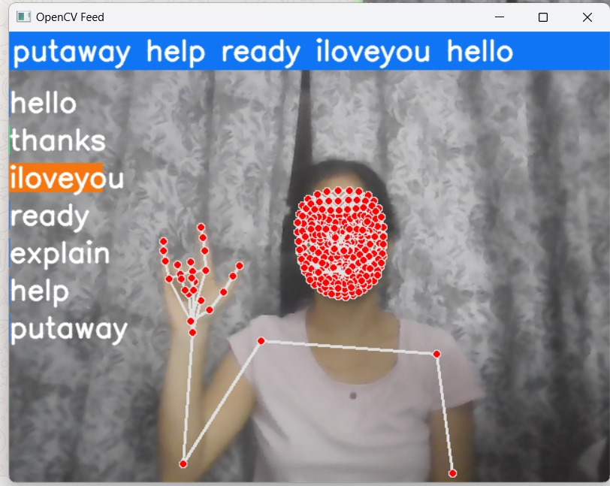
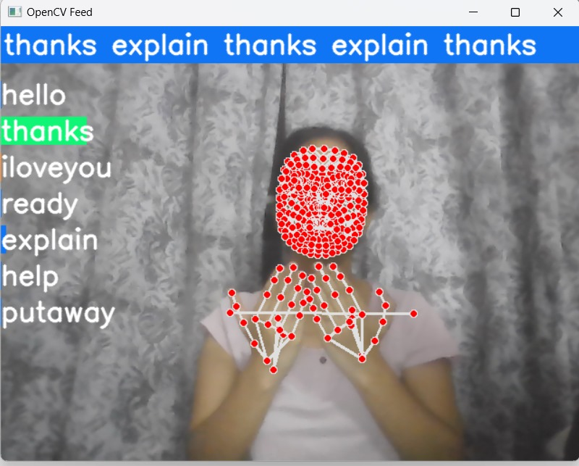
Cont…
Accuracy : 81.81%

Slide 17
Conclusion:
Thus "Beyond Words: Exploring Action Detection in Sign Language" leverages cutting-edge technologies like TensorFlow, OpenCV, and MediaPipe to enable sign language interpretation, bridging communication barriers for the hearing impaired.
By utilizing the MediaPipe Holistic model, the project captures intricate facial, body, and hand gestures, fostering a nuanced understanding of sign language expressions and enhancing interpretative capabilities.
In our model, we have given additional feature of speech conversion for sign detection enhancing accessibility of sign language interpretation.

Slide 18
Future Enhancements:
Gesture Customization for Users: Acknowledging the diversity of communication preferences, implementing a feature that allows users to customize or define their own set of personalized gestures adds a layer of personalization to the system.
Translation to Multiple Languages: Exploring translation to multiple languages can enhance the system's accessibility, making sign language interpretation inclusive across diverse linguistic communities. This future scope aims to break language barriers and promote a more widespread understanding of sign language expressions.
Enhanced Gesture Vocabulary: Enrich the system's vocabulary of recognized gestures by incorporating more signs and expressions. This expansion could involve collaboration with sign language experts and communities to ensure cultural relevance and inclusivity.

Slide 19
References:
[1] Shubham Shinde, Ashwin Kothari, Vikram Gupta, YOLO based Human Action Recognition and Localization, Procedia Computer Science,Volume 133, 2018, Pages 831-838, ISSN 1877-0509, https://doi.org/10.1016/j.procs.2018.07.112.
[2] Shi, B., Brentari, D., Shakhnarovich, G., & Livescu, K. (2021). Fingerspelling detection in american sign language. In Proceedings of the IEEE/CVF Conference on Computer Vision and Pattern Recognition (pp. 4166-4175).
[3] R. V. Prakash, A. R, A. A. Reddy, R. Harshitha, K. Himansee and S. K. A. Sattar, "Sign Language Recognition Using CNN," 2023 14th International Conference on Computing Communication and Networking Technologies (ICCCNT), Delhi, India, 2023, pp. 1-7, doi: 10.1109/ICCCNT56998.2023.10307510.

Slide 20
Thank You

